Slide 1
CoT Examples
1 Feb 2026

Slide 2
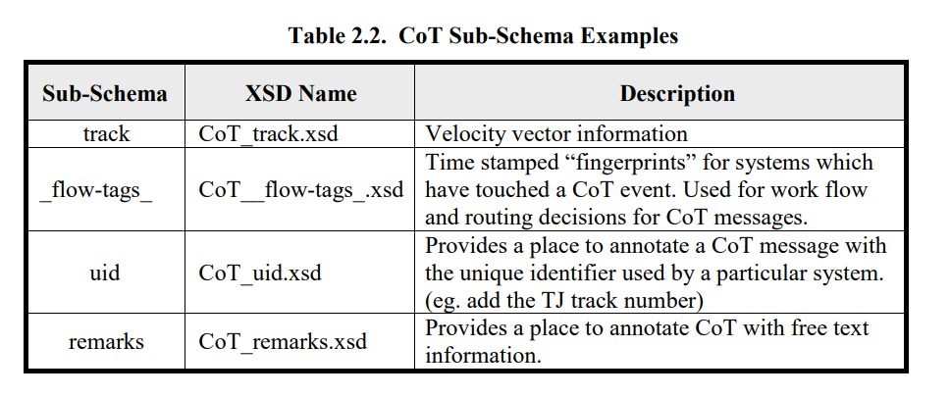
It appears that sub-schemas go in the xmlDetail field (TBC)

Slide 3
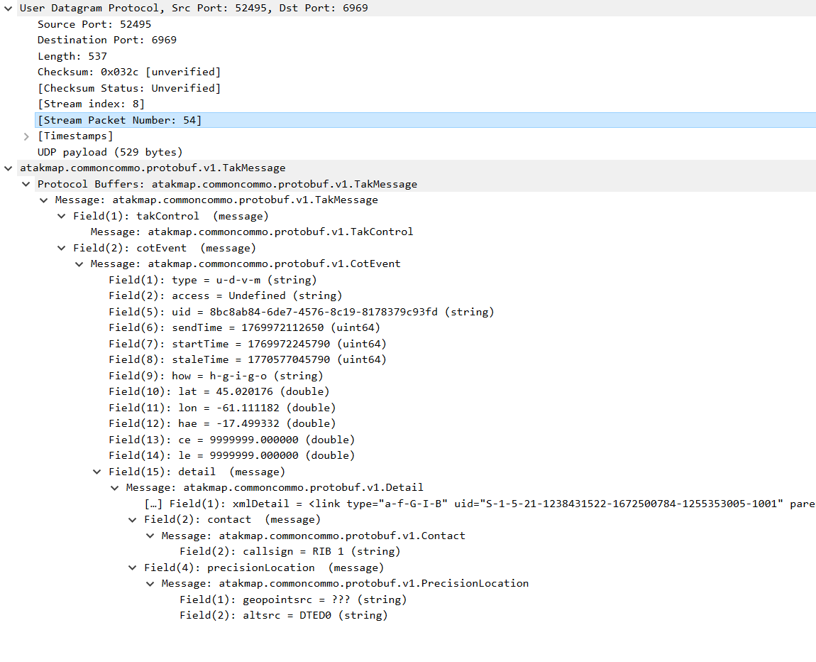
Point Dropper Tool WinTak 5.4
<link type="a-f-G-I-B" uid="S-1-5-21-1238431522-1672500784-1255353005-1001" parent_callsign="Pheonix" relation="p-p" production_time="2026-02-01T18:55:12Z"/>
<model type="vehicle" name="CRRC" category="Maritime" outline="false"/>
<track course="208.57046226"/><strokeColor value="-16744704"/>
<fillColor value="-16744704"/>
<archive/>
<remarks>BOARDING</remarks>

Slide 4
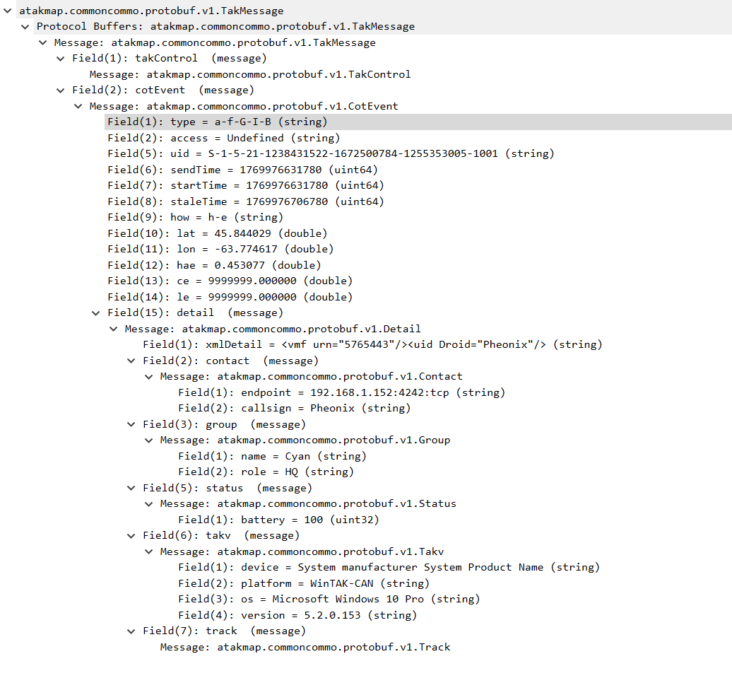
PLI
WinTak 5.4

Slide 5
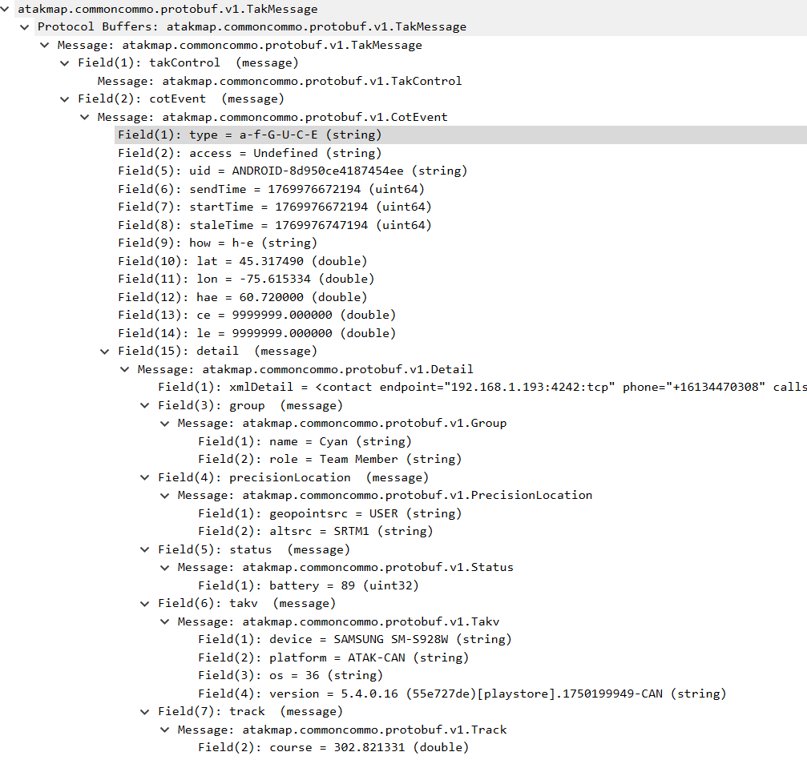
PLI
ATAK 5.4
<contact endpoint="192.168.1.193:4242:tcp" phone="+16134470308" callsign="51"/>
<remarks>fargo</remarks>
<vmf urn="5760093"/>
<uid Droid="51"/>
<vmf_plugin_detail/>

Slide 6
<?xml version="1.0" encoding="UTF-8"?>
<event version="2.0" uid="94184660-8701-409b-8a6d-6b07d6670f42" type="a-f-S" how="m-r" time="2025-09-25T17:30:33Z" start="2025-09-25T13:30:54Z" stale="2025-09-25T13:45:54Z" opex="o" qos="1-r-c"><point lat="46.92785661982636" lon="-71.51252780892038" hae="0.0" ce="0.0" le="0.0"/>
<detail>
<contact callsign="CAN-VALC-LOW" endpoint="0.0.0.0:0:tcp"/>
<track speed="0.0" course="0.0"/>
<_flow-tags_ TAK-Server-789b65a5e814479bbafe180a0b0bedd3="2025-09-25T17:30:33Z"/>
</detail>
</event>

Slide 7
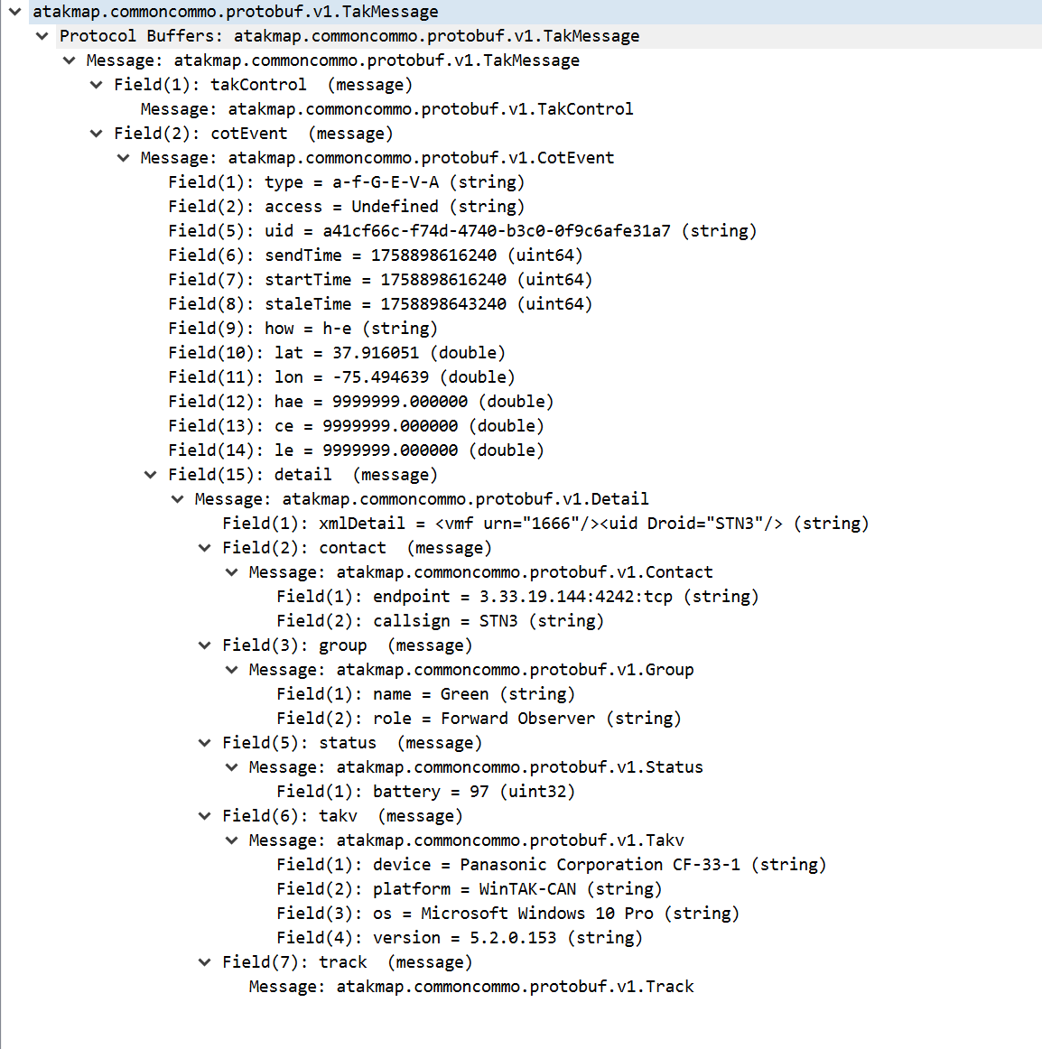

Slide 8
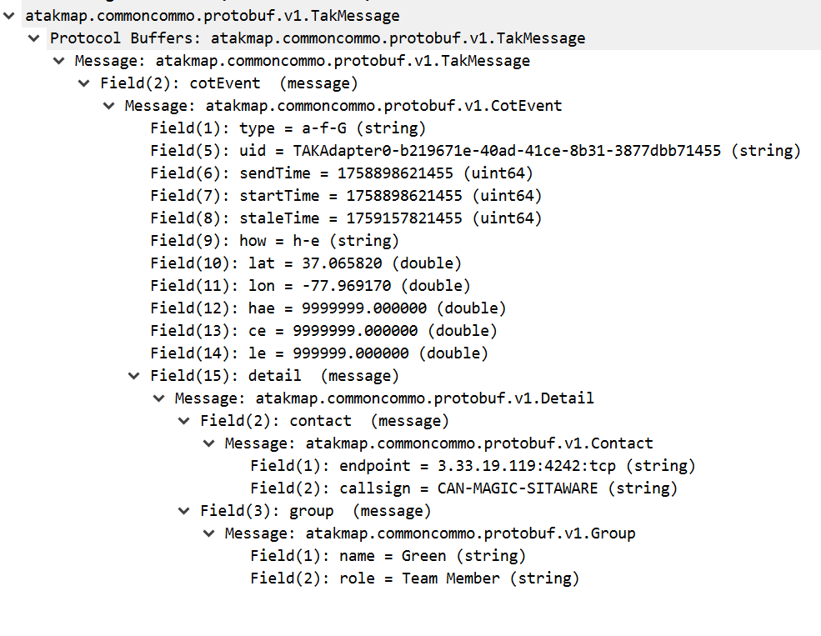

Slide 9
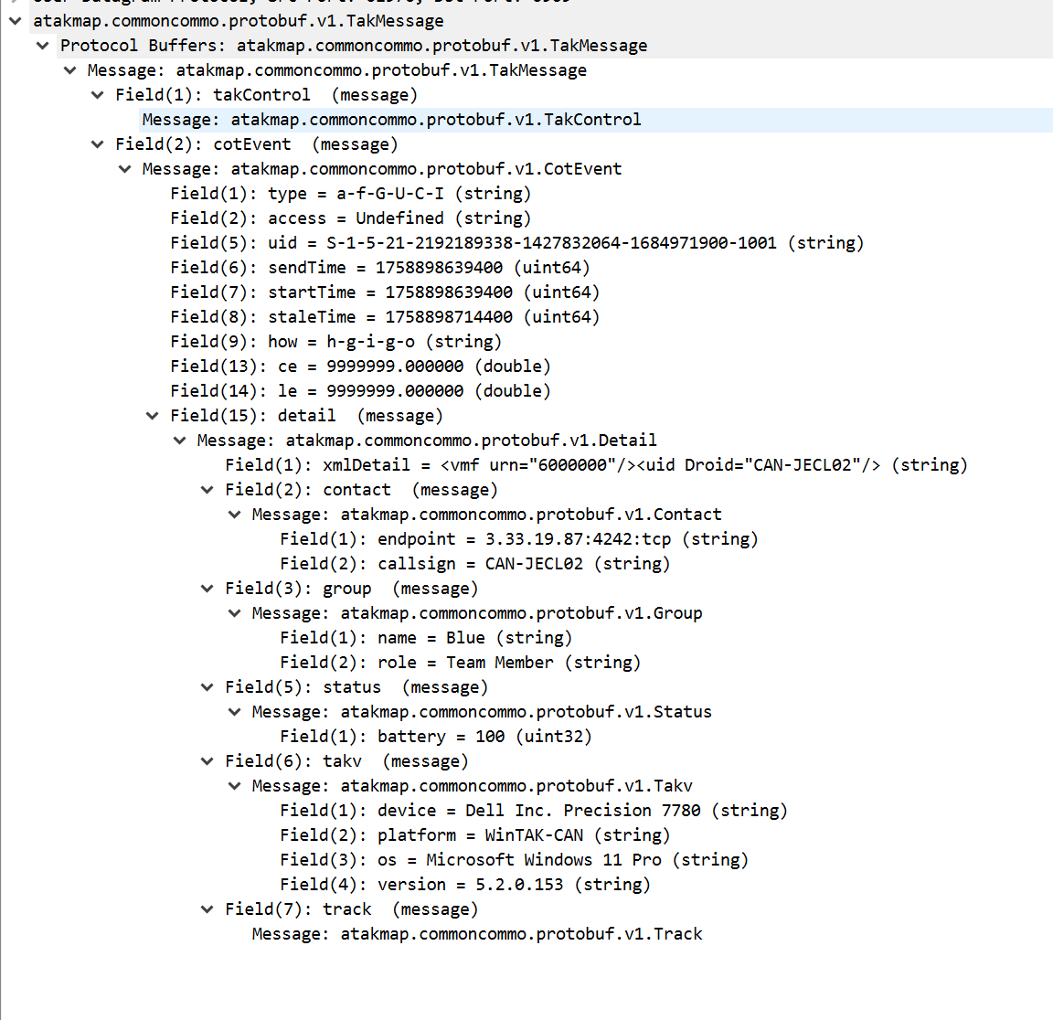

Slide 10
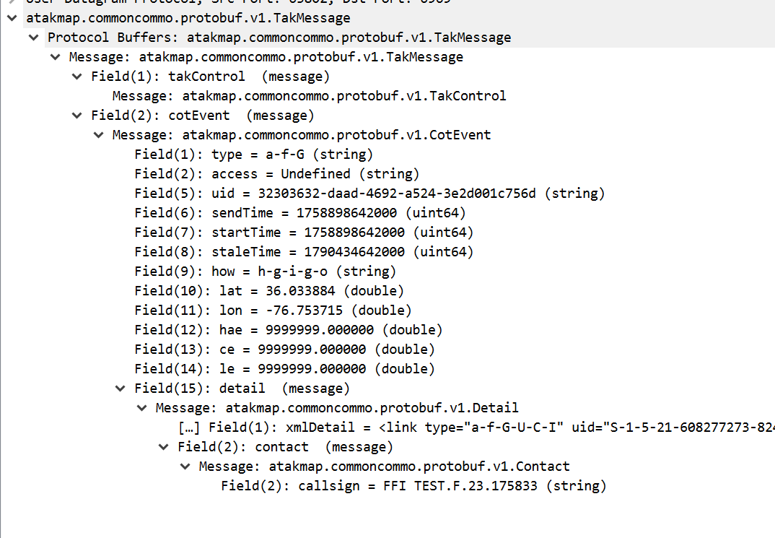
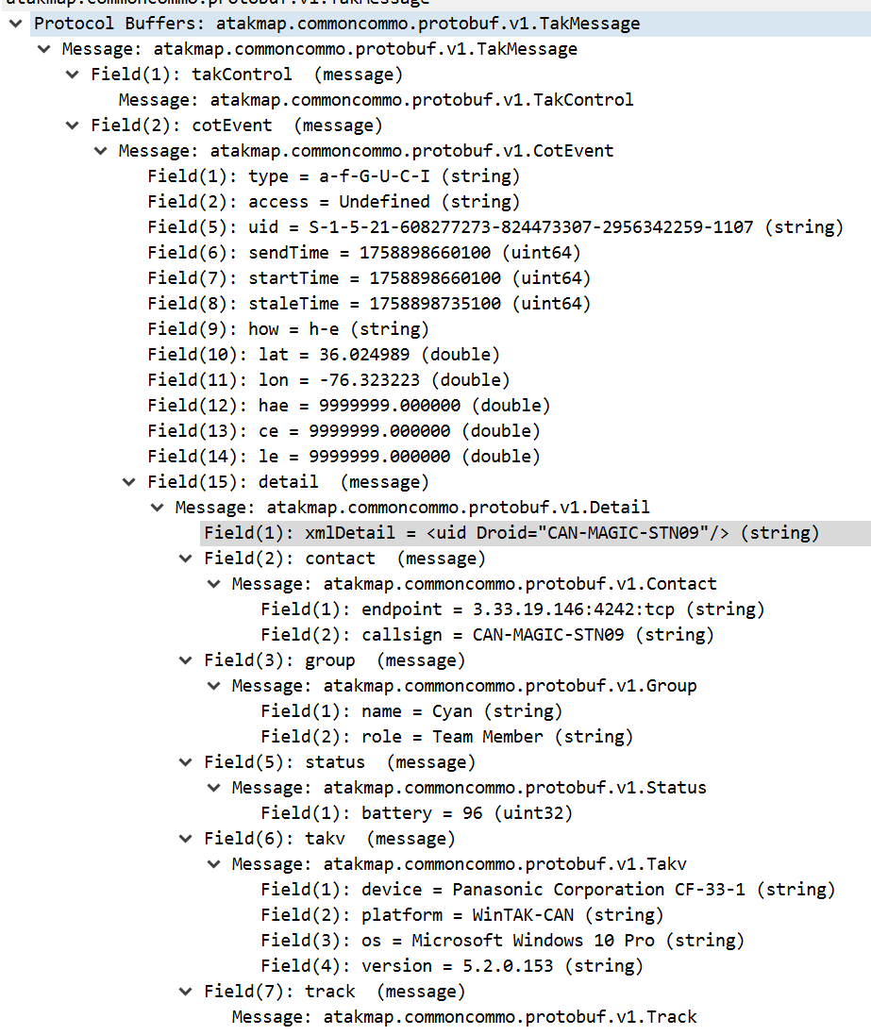
<link type="a-f-G-U-C-I" uid="S-1-5-21-608277273-824473307-2956342259-1107" parent_callsign="CAN-MAGIC-STN09" relation="p-p" production_time="2025-09-23T17:58:33Z"/>
<archive/>
<usericon iconsetpath="COT_MAPPING_2525C/a-f/a-f-G"/>
<height_unit>1</height_unit>

Slide 11
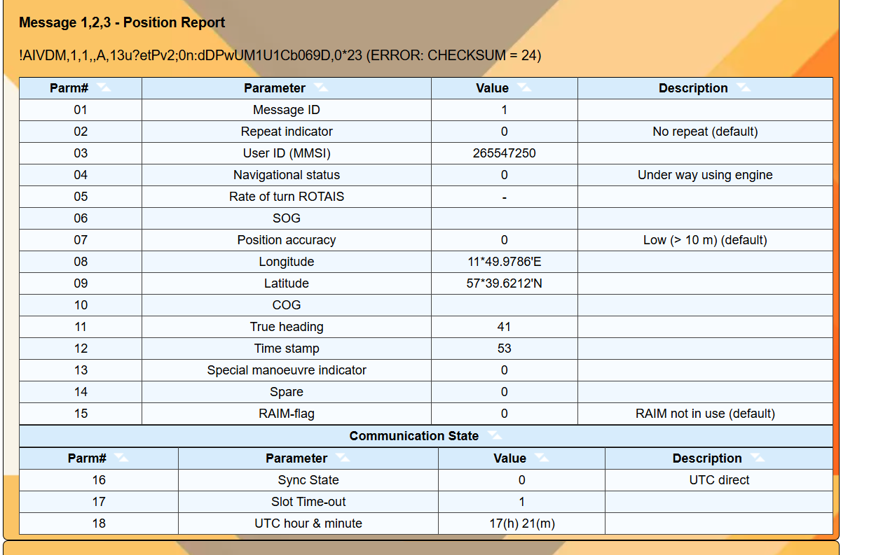
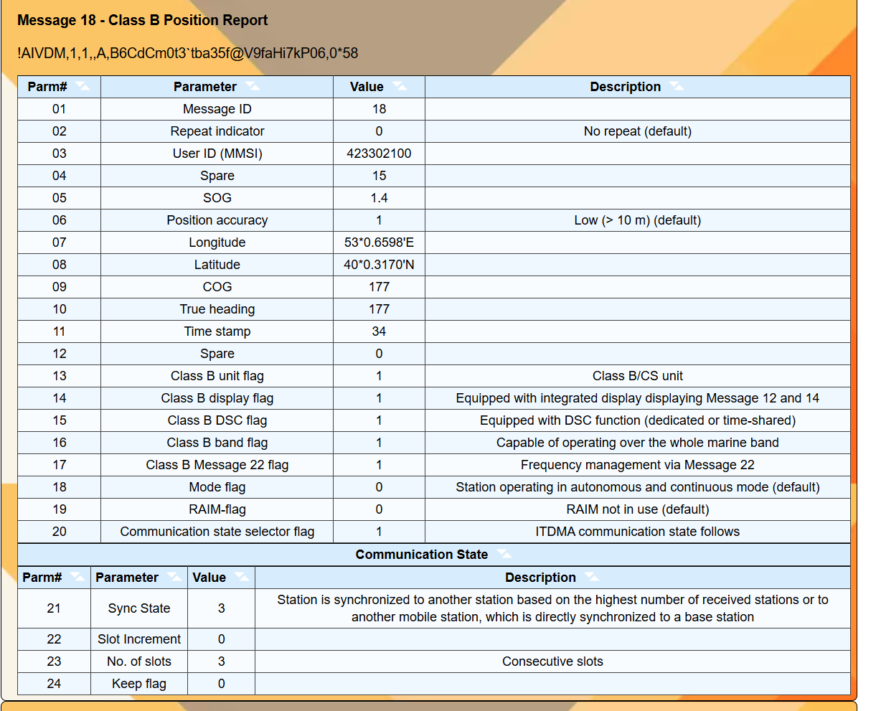
18 does not have NavStatus

Slide 12
